Slide 1

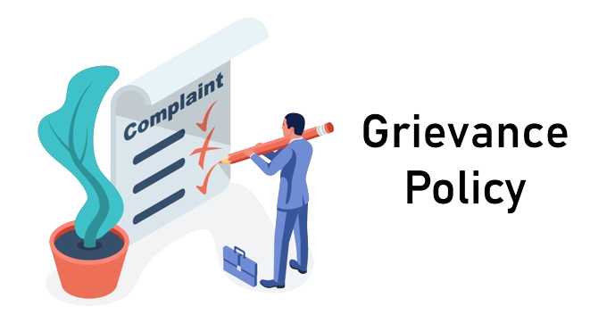

L.J. SCHOOL OF COMPUTER APPLICATIONS
Project Title
Student grievance management system
Group No: - IMCA_6_A_1
Developed By:
1. | Shah Harsh M | 21004501210056
2. | Rami Harit M | 21004501210053
3. | Kanzariya Kanji S | 21004501210019

Slide 2
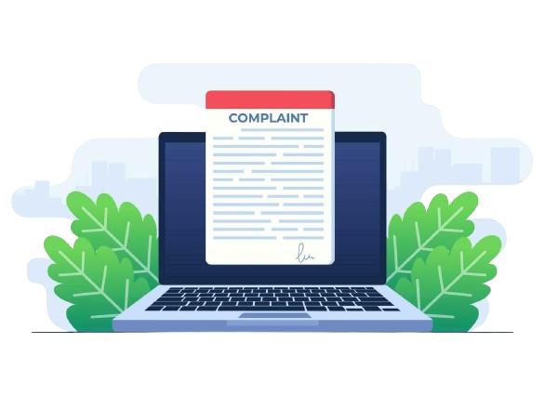
Presentation Flow
Project objective
Technology Platform Overview
Assumptions and Constraints
Timeline Chart
Targeted Users
Interaction Diagram
Features of Project
Coding Standards
Agile Project Charter
Conclusion

Slide 3

Project objective:-
The objective of the new student grievance system is to completely replace the existing one by automating processes, maintaining consistency, and cutting down on delays. It promotes confidence among stakeholders, emphasizes accountability and openness, and offers real-time updates.
It facilitates timely communication between parties by lowering information latency through automated notifications. Web portals encourage accessibility, encouraging convenience and diversity. Validation and integrity checks improve data accuracy, facilitating trend analysis and well-informed decision-making.

Slide 4
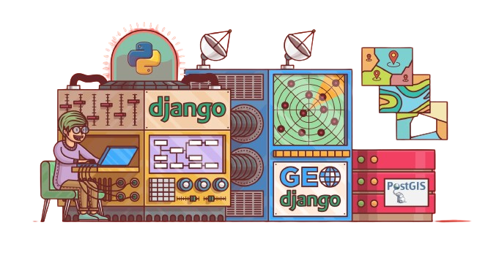

Technology Platform Overview:-
Platform -: Web Application
Web Application Development Framework : Django
Developing Language : Python
Flow of Django : Model-View-Templet(MVT)
Django Versions : 4.2.11(LTS)
Latest Release Date : December 4, 2023
Database : Sqllite

Slide 5


Assumptions and Constraints:-
Assumptions:
1.Support from Stakeholders: It is expected that the student grievance system's implementation will be actively supported and participated in by stakeholders, such as academics, administrative staff, and students.
2.Technical Infrastructure: It is anticipated that the system's development, deployment, and operation will be supported by the availability of the technical infrastructure, which includes servers, network resources, and software tools.
3.Data Availability: It is expected that pertinent data, including grievance records from the past, shall be easily accessible and properly maintained for the purposes of system development and testing.

Slide 6
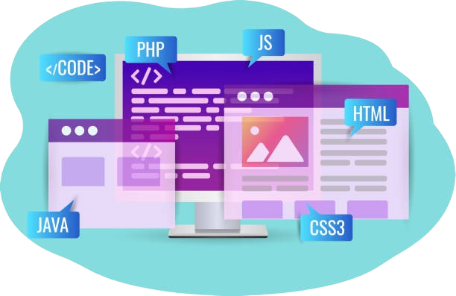
Assumptions and Constraints:-
Constraints:
1.Semester-based Routing: The Head of Department (HOD) of the relevant semester should automatically receive complaints. For example, if a student is in the 5th semester, their complaint should be directed to the HOD of the 5th semester.
2.Verification of Authorization: Only students who are enrolled in that semester at this time should be able submit complaints about it. This verifies that grievances are genuine and coming from involved students.

Slide 7
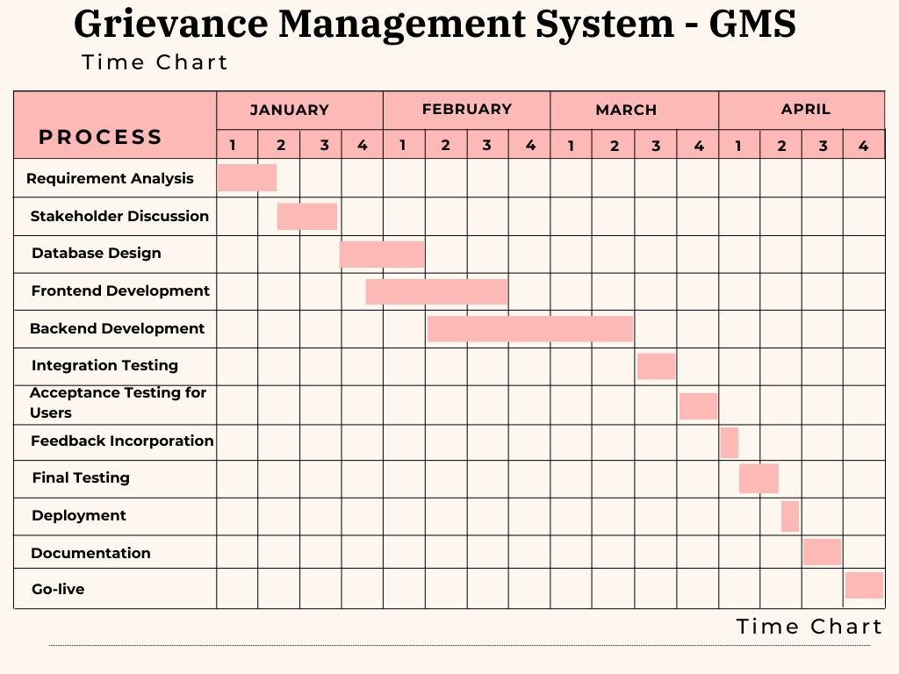
Timeline Chart:-

Slide 8


Targeted Users:-
Students:
Role: File grievances, monitor grievance progress and provide feedback on the resolution procedure.
HOD:
Participate in the grievance resolution process, examine and accept student grievances, and offer suggestions and feedback.
Administrators:
Role: Coordinate and direct the grievance resolution procedure, designate grievances to the relevant staff, and keep tabs on the status of grievances.

Slide 9
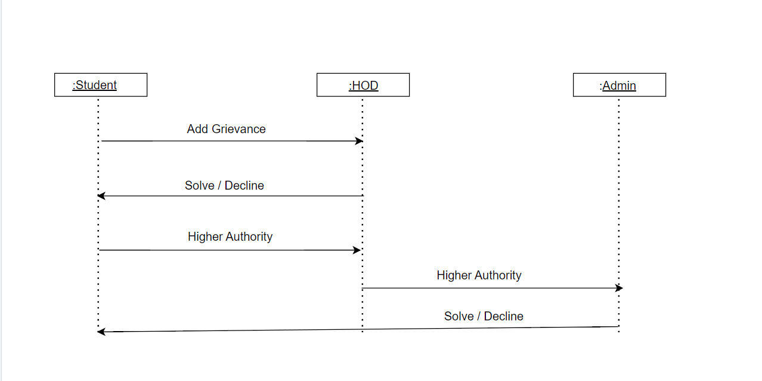

Interaction Diagram:-

Slide 10
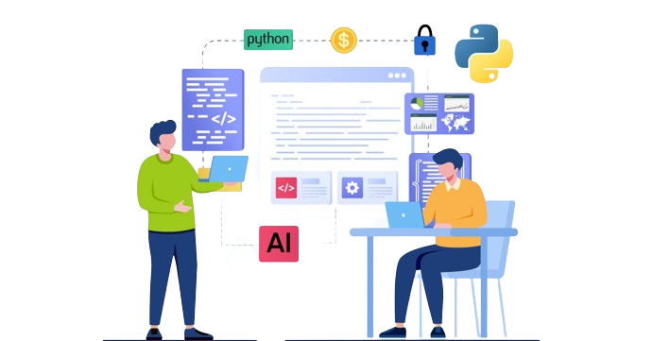
Features of Project:-
A hierarchical resolution structure, beginning with the Head of Department (HOD) and moving through administrative levels as needed, is a facet of your student grievance management project. Students can monitor the progress of their complaints with its help.
For maintaining student information, the system interfaces with Excel sheets and a database. It also enables grievances with opinions to be viewed and resolved by administrators at all levels. Transparency, efficiency, and accessibility are given top priority by the platform, which facilitates data-driven decision-making and offers clear channels of communication.

Slide 11

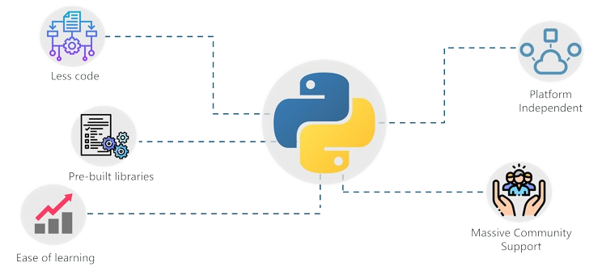
Coding Standards:-
Following naming conventions and coding guidelines was essential to preserving uniformity and readability across the codebase when the student grievance management system was being developed.
Variables, functions, and classes were given meaningful and descriptive names that clearly communicated their functions and purposes. In addition, significant remarks were included when needed to clarify intricate algorithms or give background information for upcoming developers.

Slide 12
Agile Project Charter:-
General Project Information
Project Name | Student Grievance Management System
Project Champion | Kanzariya Kanji,Harsh Shah,Harit Rami
Project Sponsor | Company name
Project Manager | Monica Gahlawat
Stakeholders | L.J Institute Of Computer Application
Expected Start Date | 9-1-2024
Expected Completion Date | 1-4-2024
Project Details
Mission | The mission of the Grievance Management System is to handle and control gravity-related challenges.
Vision | The Grievance Management System's mission is to transform the understanding, application, and navigation of gravity for the benefit of human exploration, science, and technology.
Scope | The scope of a Student Grievance Management System encompasses efficient complaint submission, centralized tracking, confidentiality, communication facilitation, documentation, analytics, integration, accessibility, training, compliance, and continuous improvement.

Slide 13
Conclusion:-
In conclusion, enhancing a student grievance management system with features such as anonymous reporting, automated tracking, and a user-friendly interface can significantly improve its effectiveness in addressing student concerns. By implementing these enhancements, educational institutions can foster a supportive academic environment, promote transparency and accountability, and better serve the needs of their student community. It's imperative for institutions to continually review and update their grievance management systems to ensure they remain responsive to the evolving needs of students and maintain trust and confidence in the academic community.

Slide 14
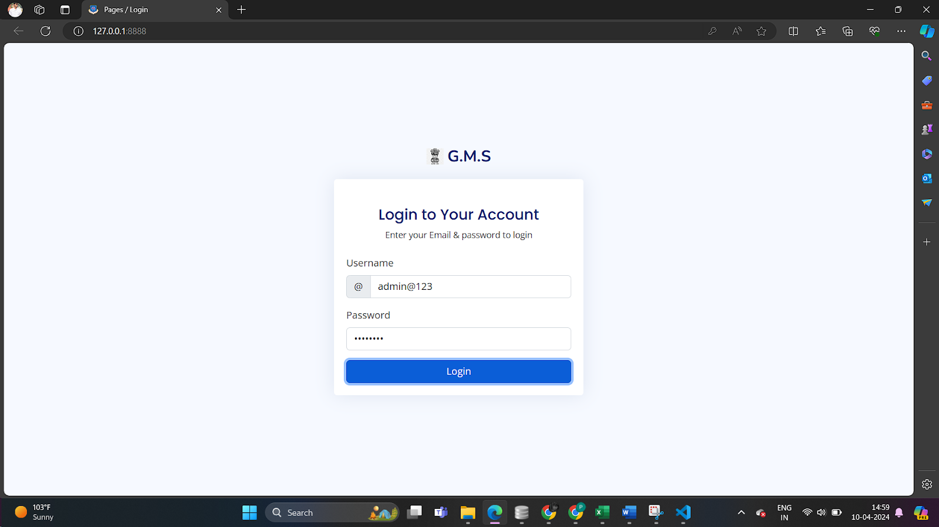
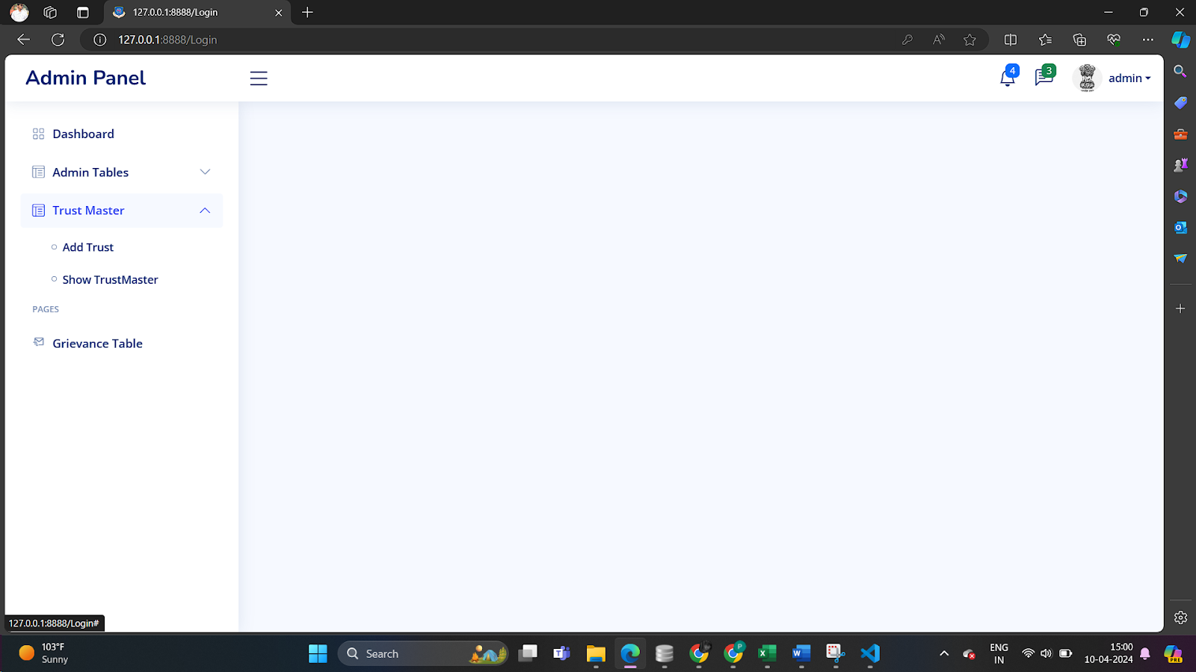
Login Page
Dashboard Page

Slide 15
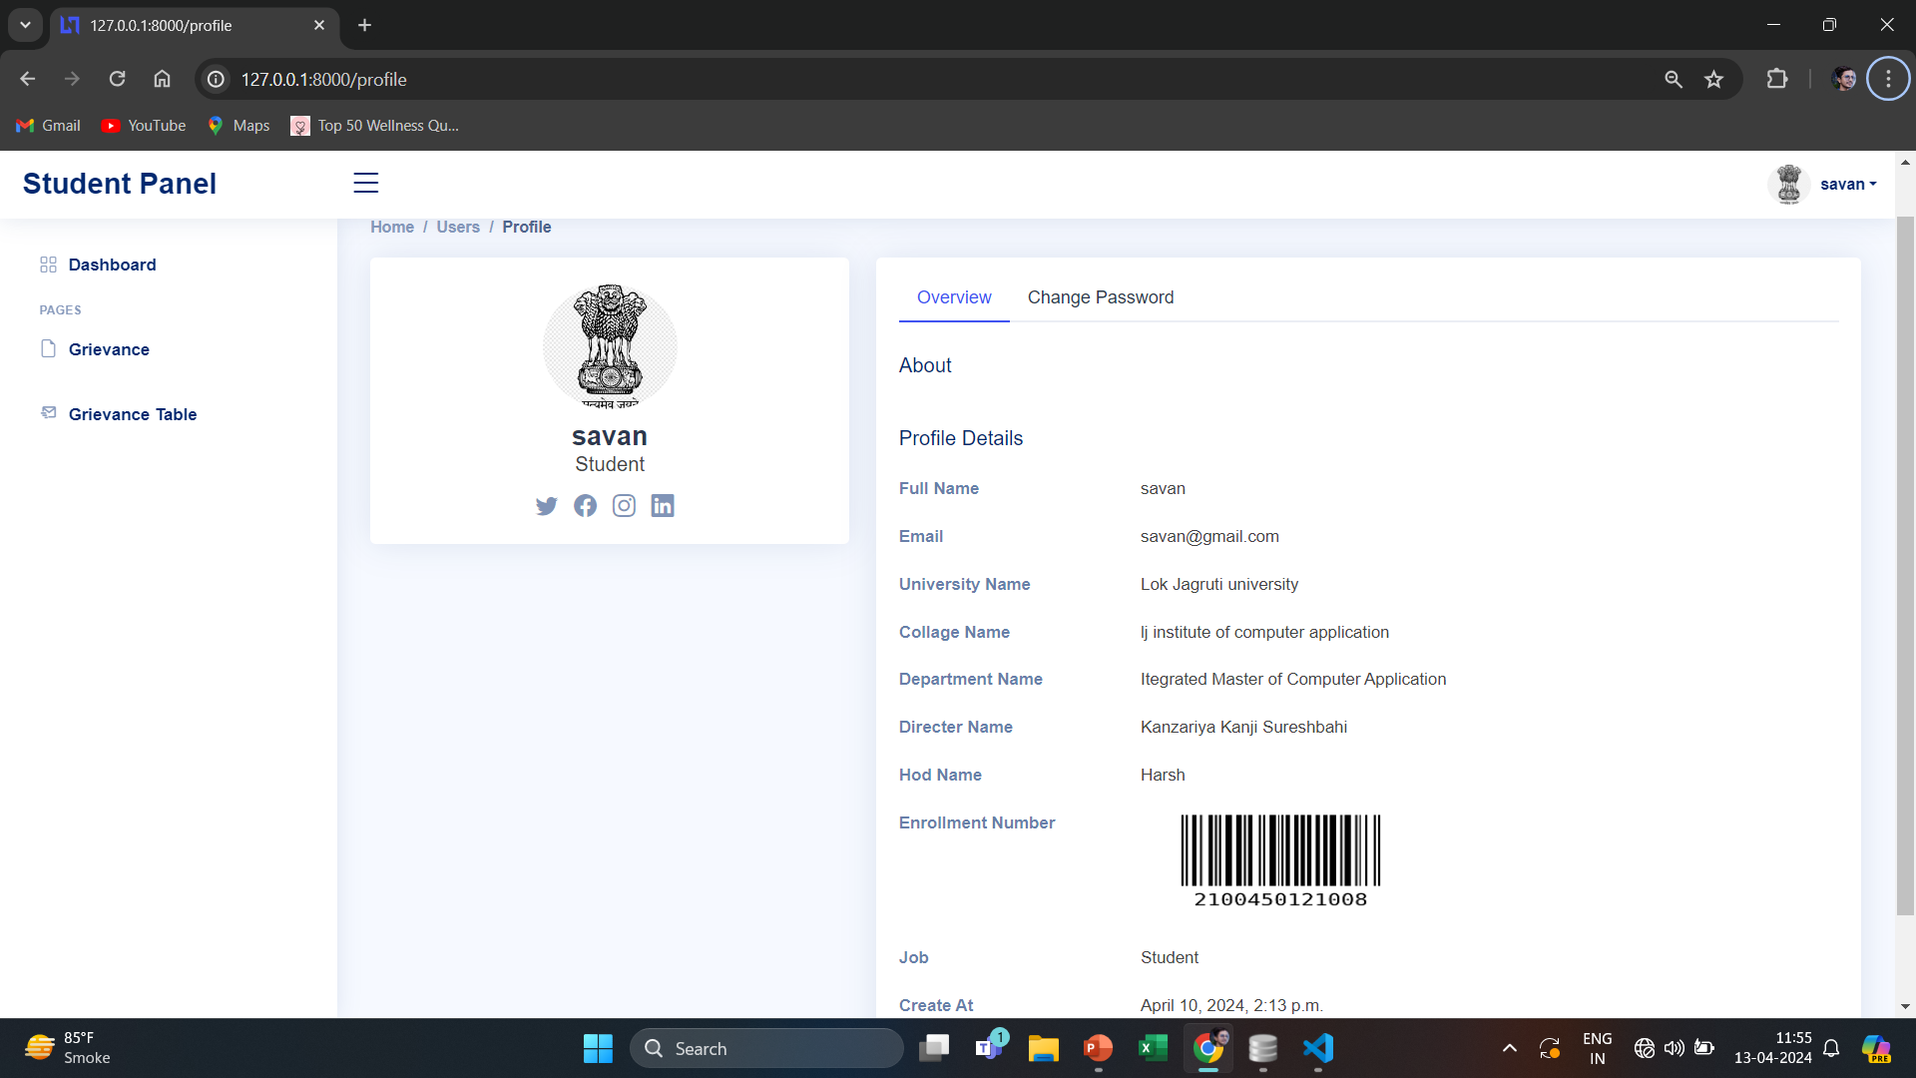

Slide 16


